Slide 1
Elements and Compounds
Chapter 3
Outline
Elements and Symbols
The Periodic Table
Compounds and Formulas
  Molecules and Ionic Compounds
  Law of Definite Proportions
  Law of Multiple Proportions

Slide 2
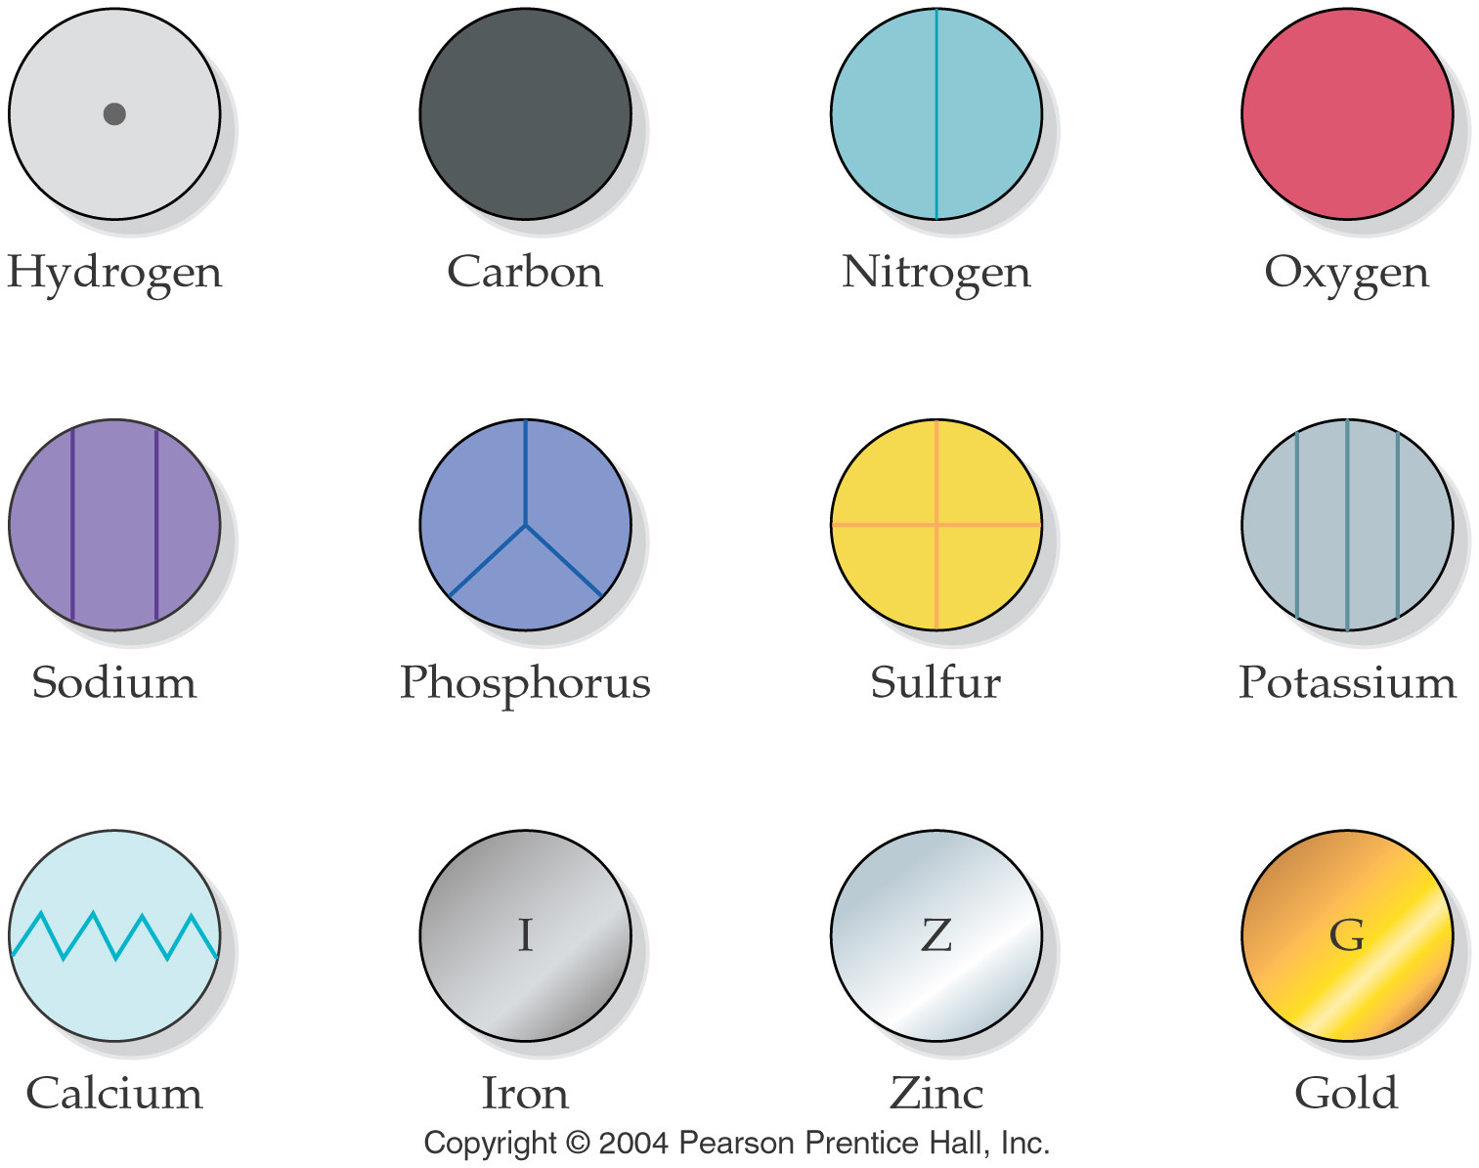
What symbols did Dalton want to use for the elements?

Slide 3
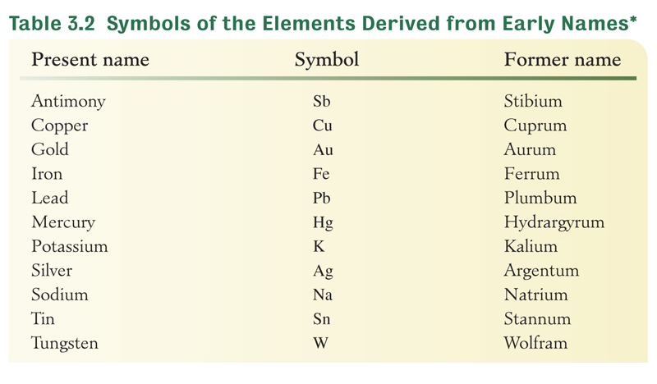
Why don’t all symbols match their name?

Slide 4
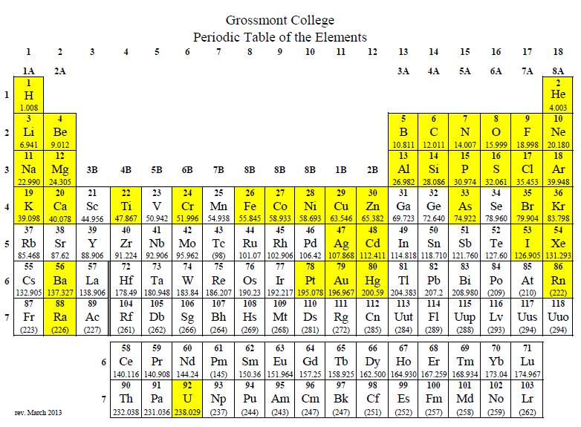
What elements do you need to know?

Slide 5
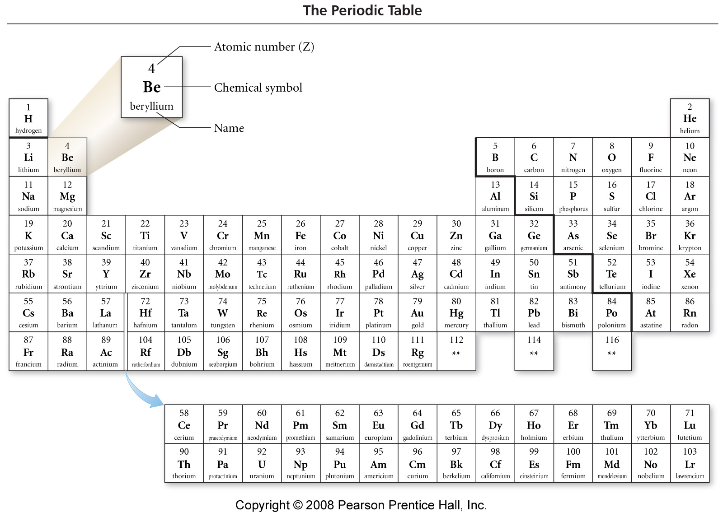
Notes:
Figure: 02-09
Title:
The Periodic Table
Caption:
Each element is represented by its symbol and atomic number. Elements in the same column have similar properties.

Slide 6
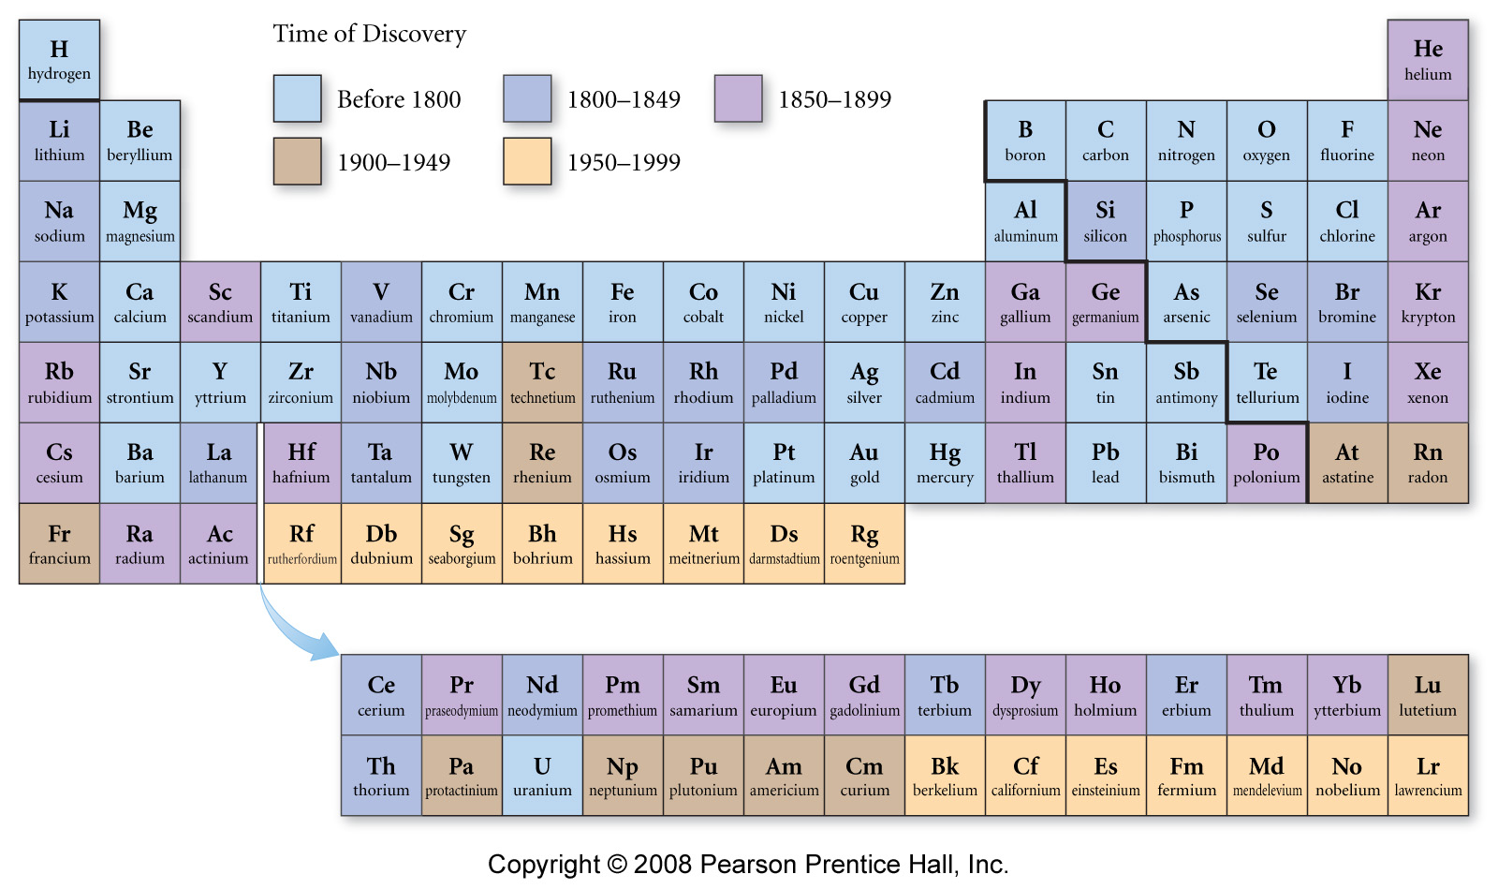
Notes:
Figure: 02-09-05UN
Title:
Time of Discovery Periodic Table
Caption:
Many of the elements that we know today were discovered during Mendeleev's lifetime.

Slide 7
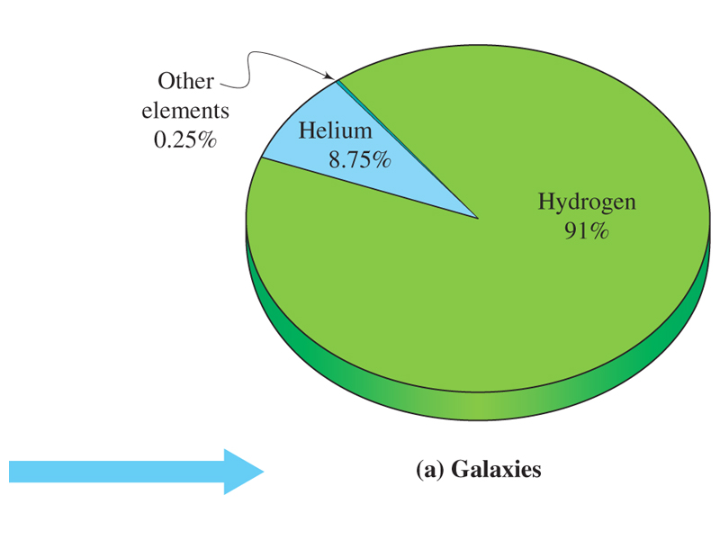
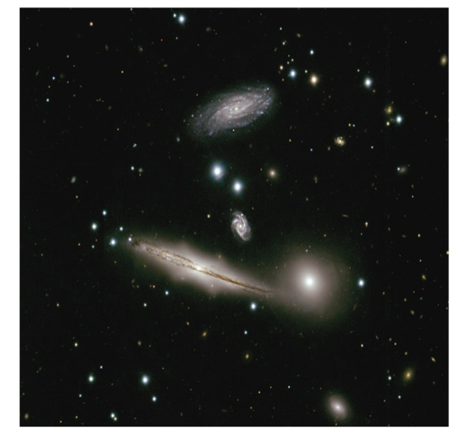
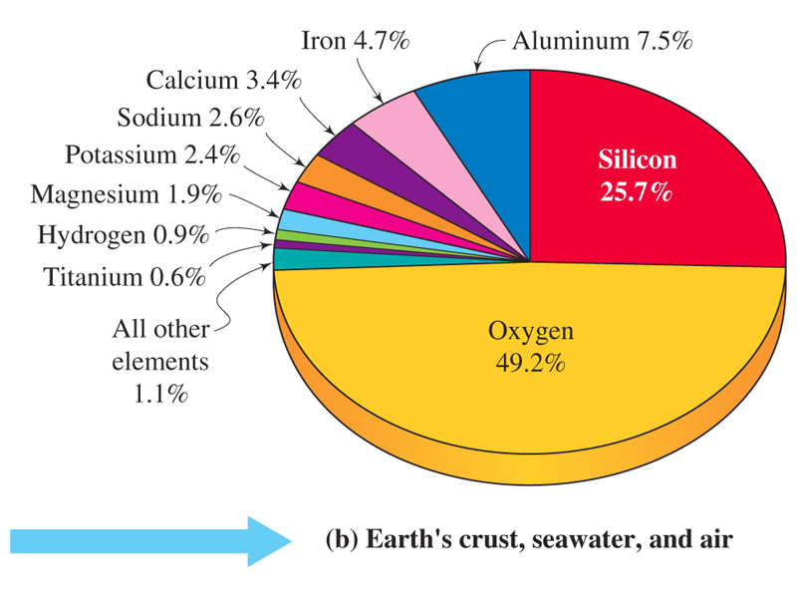
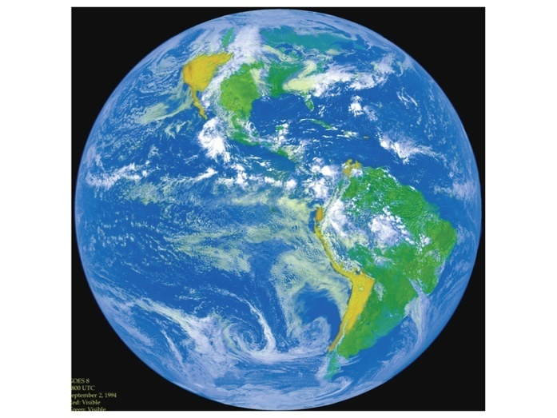
Distribution of the common elements in nature.
3.2

Slide 8
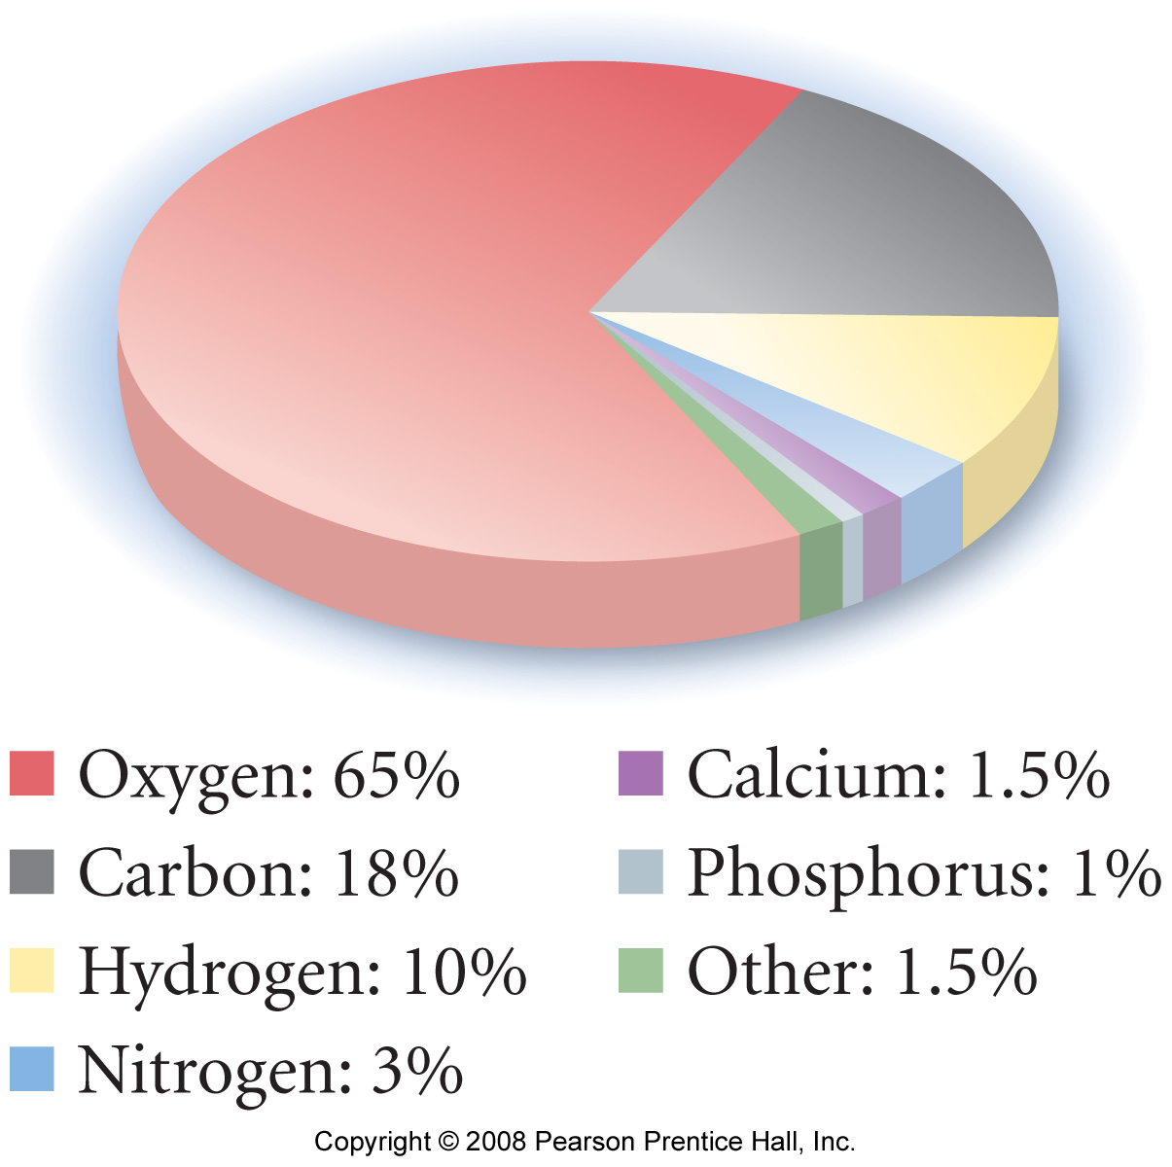
Elemental Composition of Humans (by mass)
Notes:
Figure: 02-15
Title:
Elemental Composition of Humans (by Mass)
Caption:
By mass, our bodies are mostly oxygen atoms because of the large amount of water in our bodies. Carbon comes in second and hydrogen third.

Slide 9
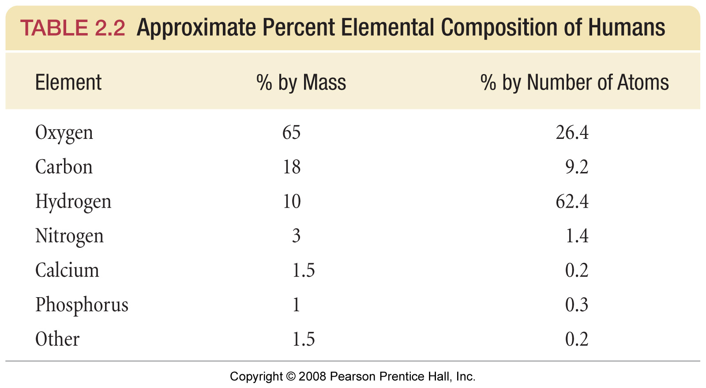
Notes:
Figure: 02-T02
Title:
TABLE 2.2 Approximate Percent Elemental Composition of Humans
Caption:
By mass, our bodies are mostly oxygen atoms because of the large amount of water in our bodies. Carbon comes in second and hydrogen third.

Slide 10
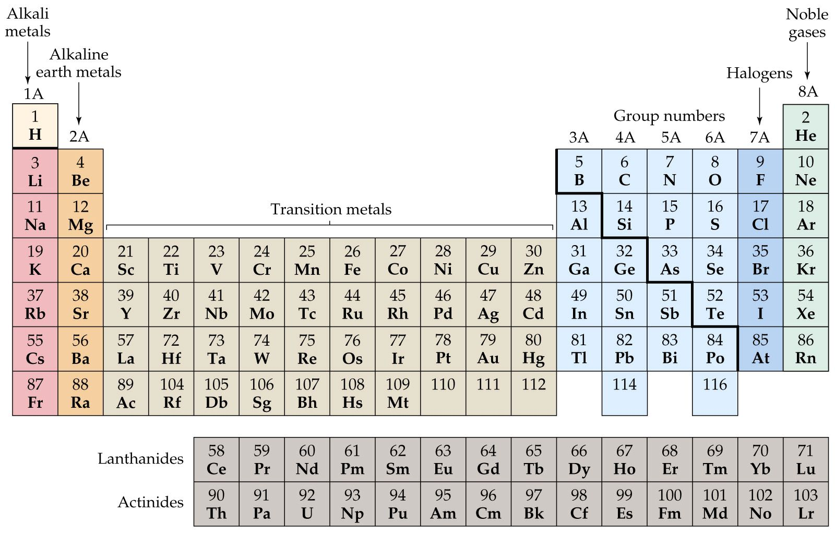

Slide 11
Expanded Periodic Table

Slide 12
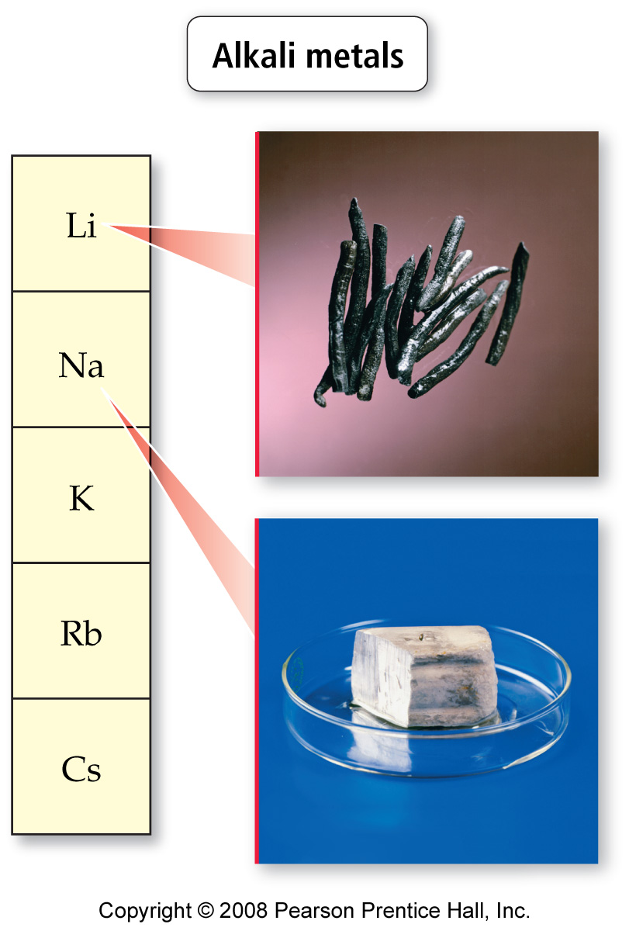
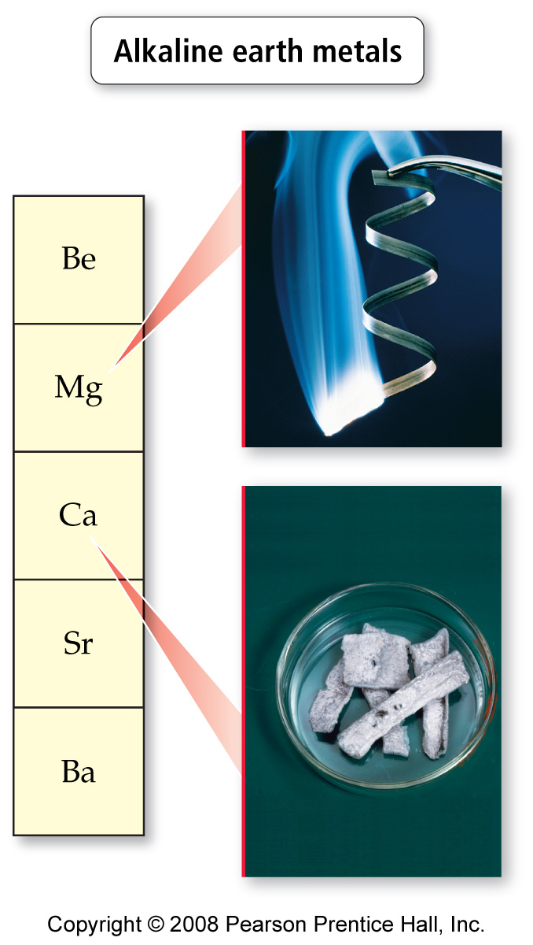
Notes:
Figure: 02-13-01
Title:
Noble gases
Caption:
The noble gases get their group name from their reluctance to react with other elements.

Slide 13
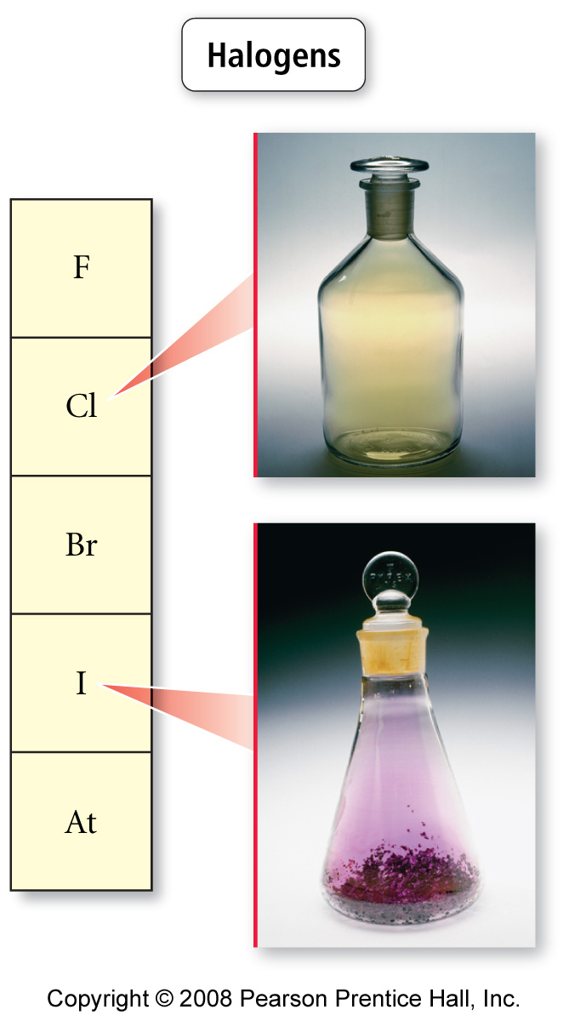
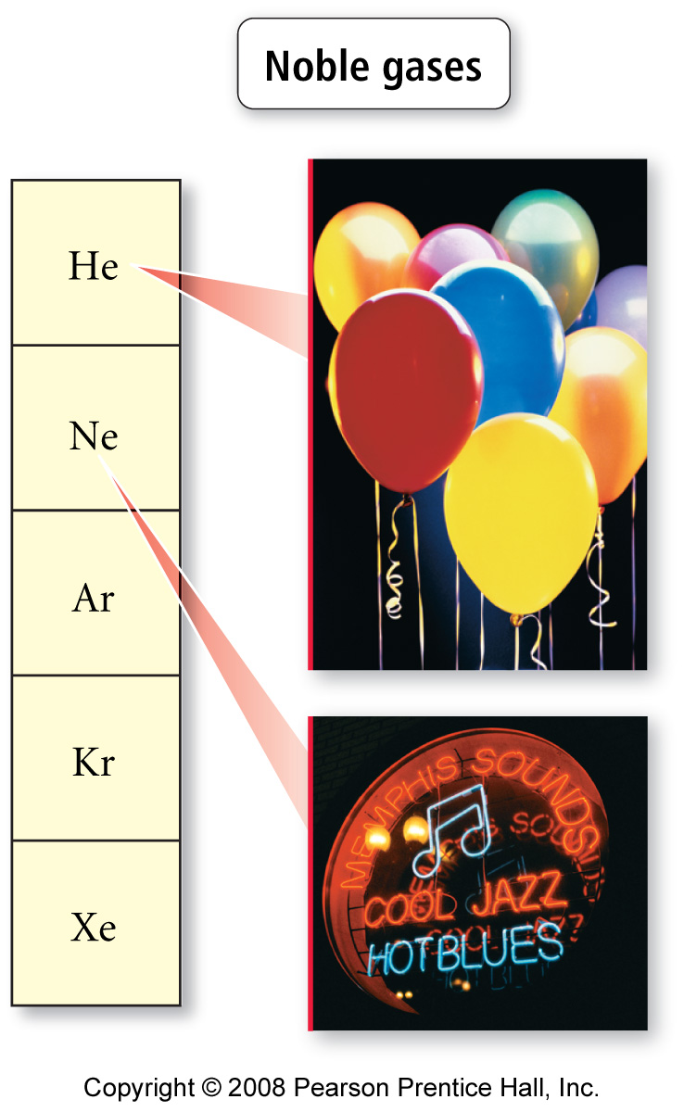
Notes:
Figure: 02-13-04
Title:
Halogens
Caption:
Halogens are reactive nonmetals.

Slide 14
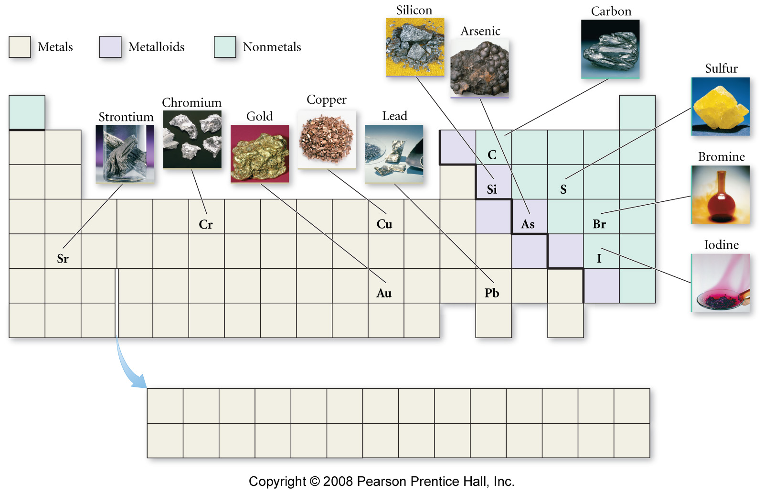
Notes:
Figure: 02-12-01UN
Title:
Some representative metals, metalloids, and nonmetals
Caption:
Commonly-encountered elements are found throughout the periodic table.

Slide 15
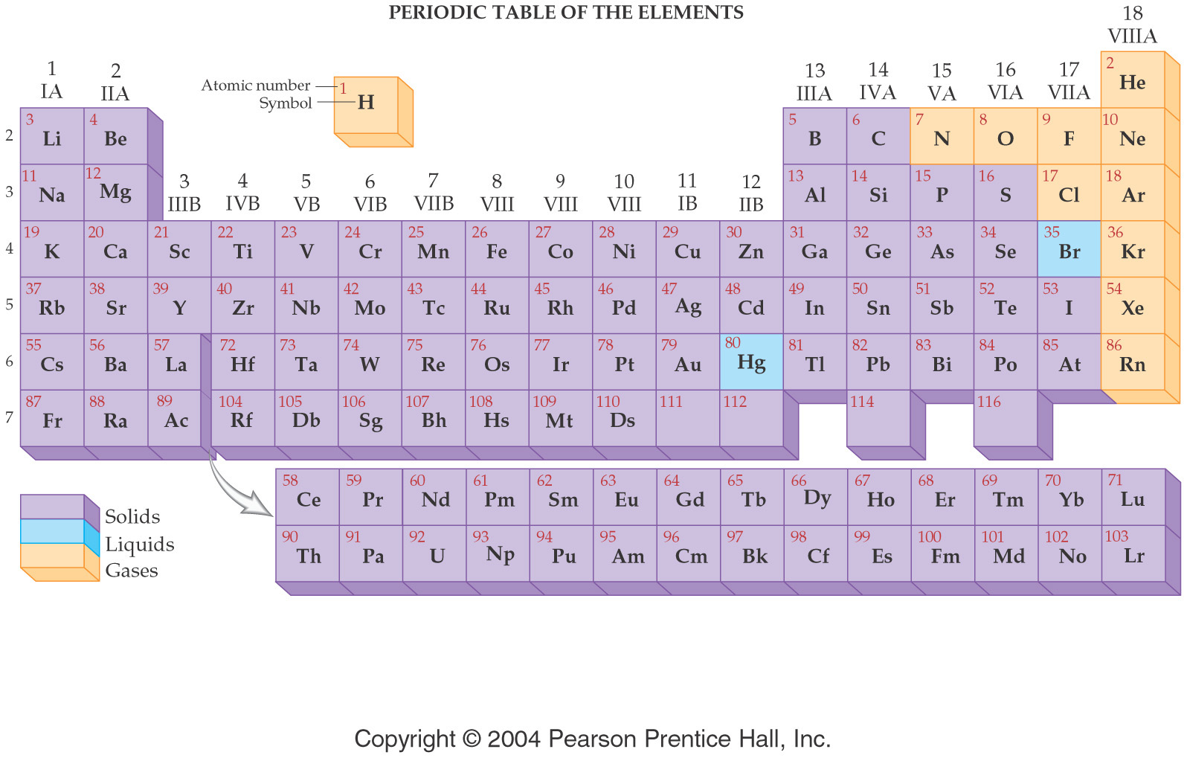

Slide 16
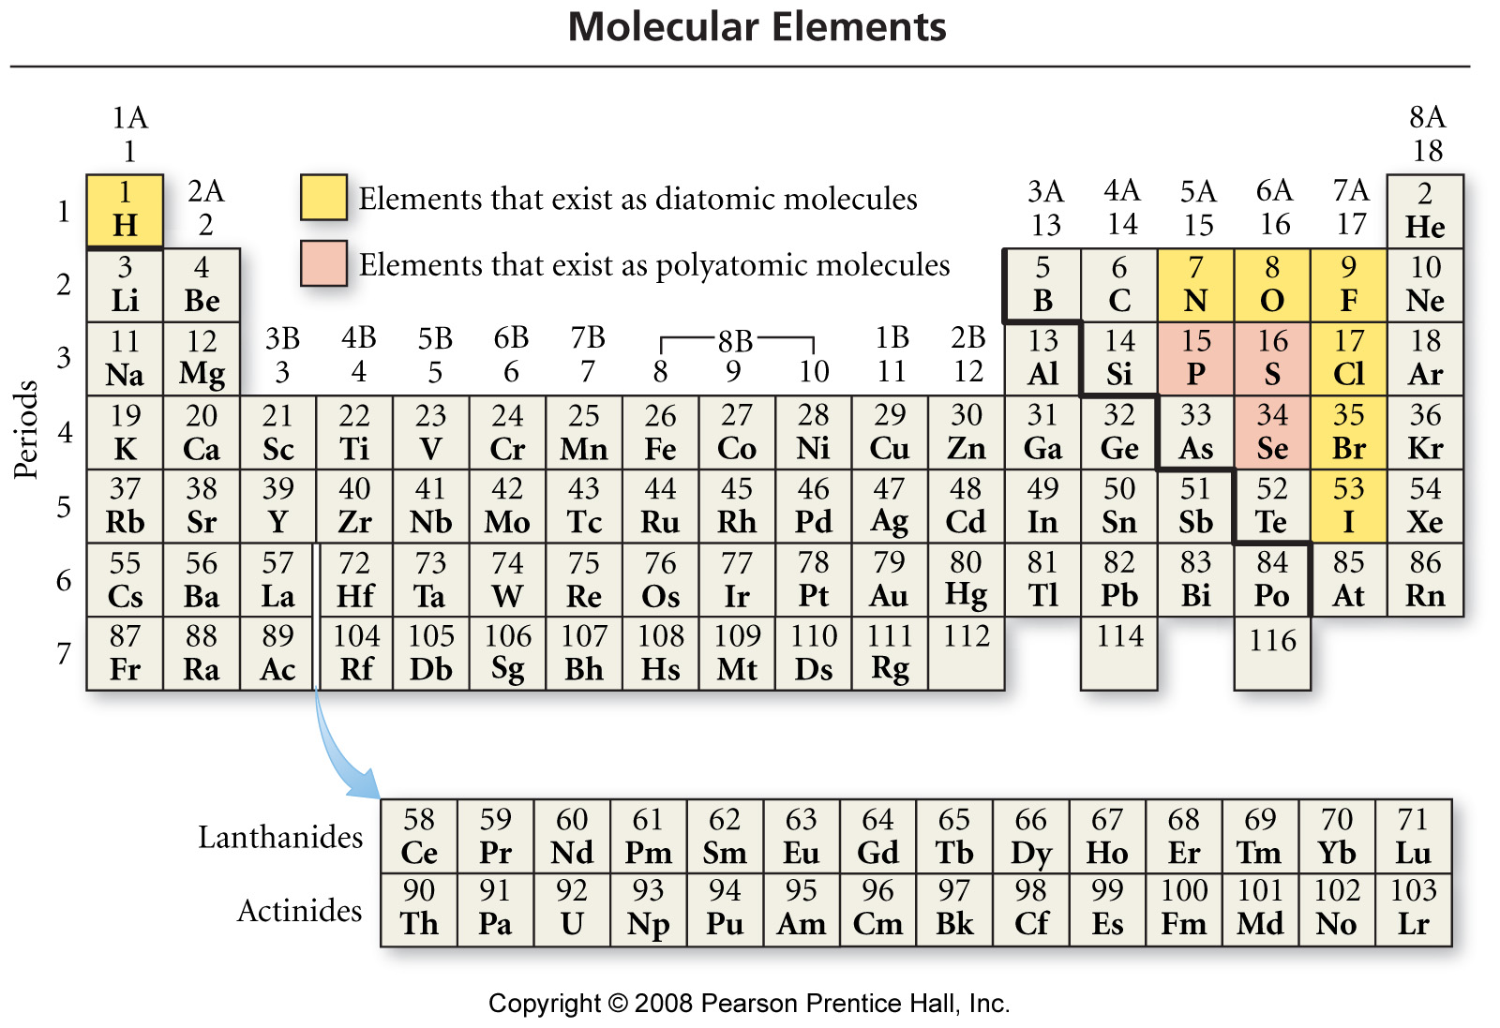
Notes:
Figure: 03-04
Title:
Molecular Elements
Caption:
The highlighted elements exist primarily as diatomic molecules (yellow) or polyatomic molecules (red).

Slide 17
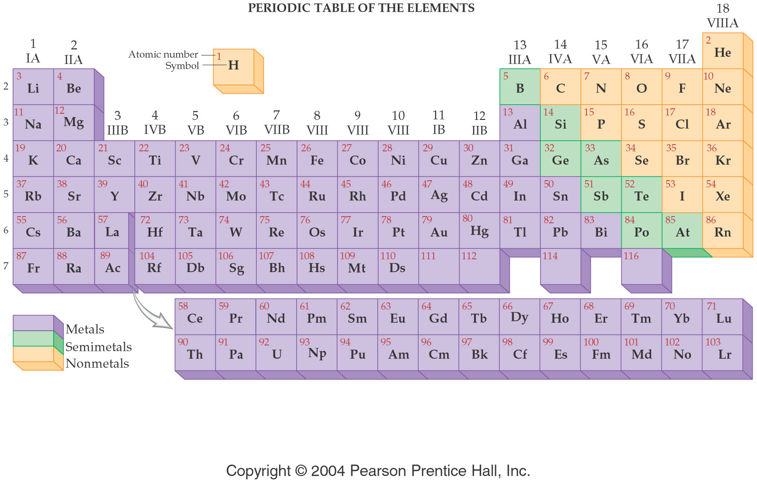

Slide 18
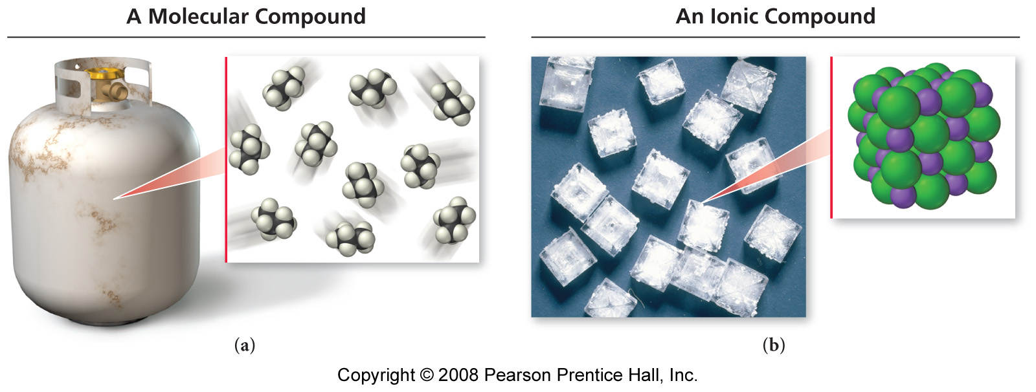
How do molecular and ionic compounds differ?
Propane – contains
individual C₃H₈
molecules
Table salt – contains
an array of Na⁺ ions
and Cl⁻ ions

Slide 19
Chemical Formulas
AxByCz
Elemental Symbol
Number of atoms

Slide 20
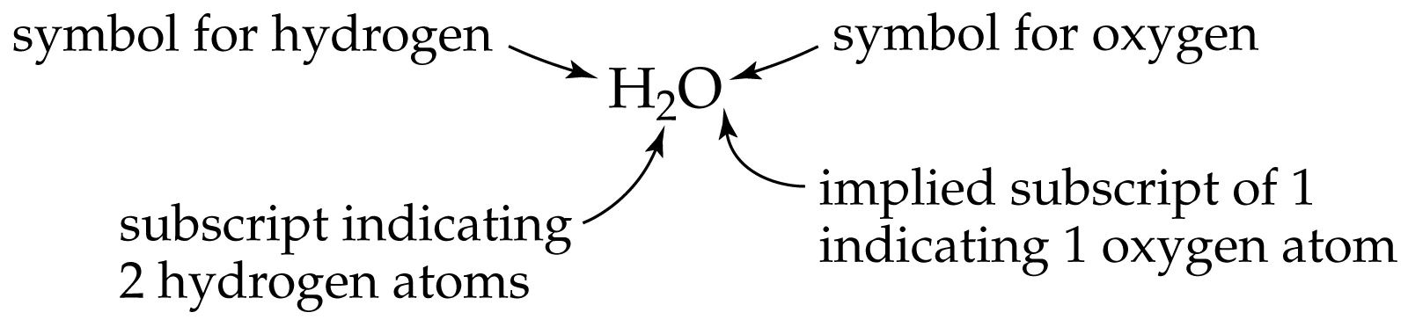

Slide 21
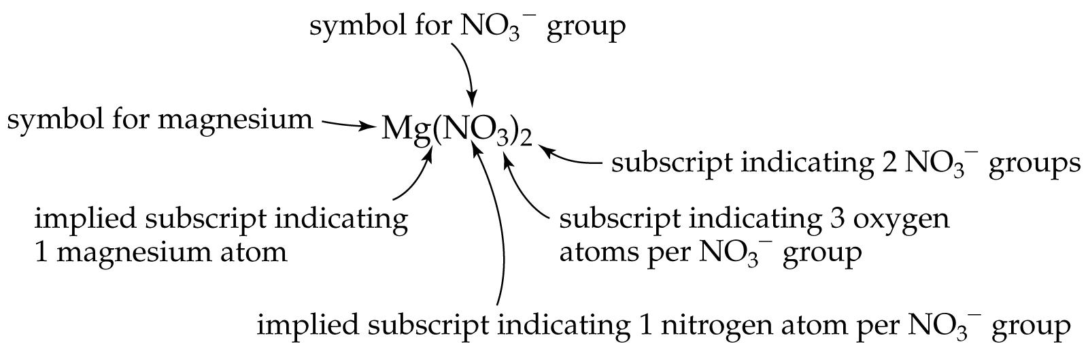

Slide 22
Example - Law of Definite Proportions
Sample size | Mass hydrogen | Mass Oxygen | Formula of Compound
100.0 g | 11.2 g | 88.8 g | H₂O
200.0 g | 22.4 g | 177.6 g | H₂O
18.010 g | 2.016 g | 15.994 g | H₂O

